Slide 1
cholinoceptors
muscarinic receptors:
the production of the second messengers inositol-1,4,5-trisphosphate (IP3) and diacylglycerol (DAG).
IP3 causes an increase in intracellular Ca2+. Calcium can then interact to stimulate or inhibit enzymes or to cause hyperpolarization, secretion, or contraction.

Slide 2
Diacylglycerol activates protein kinase C, an enzyme that phosphorylates numerous proteins within the cell.
activation of the M2 subtype on the cardiac muscle stimulates a G protein, designated Gi, that inhibits adenylyl cyclase and increases K+ conductance. the heart responds with a decrease in rate and force of contraction.

Slide 3
2. Nicotinic receptors:
functions as a ligand-gated ion channel.
Binding of ACh allows the entry of sodium ions, resulting in the depolarization of the effector cell.
Nicotinic receptors are located in the CNS, the adrenal medulla, autonomic ganglia, and the neuromuscular junction (NMJ) in skeletal muscles.

Slide 4
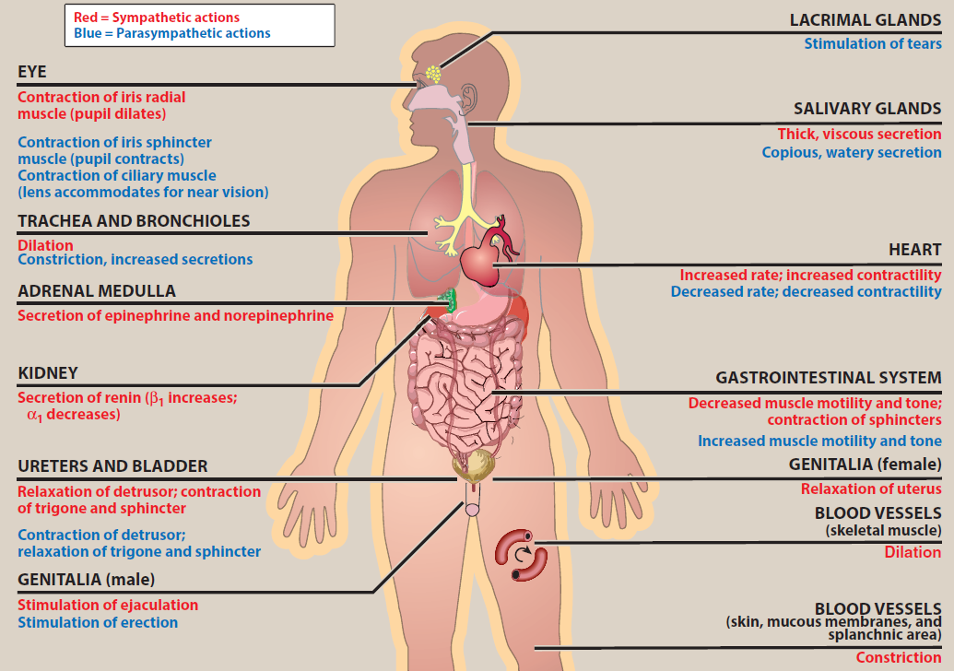

Slide 5
Trachea and bronchioles
-Dilation β₂ -Constriction, increased secretions M₃
Heart
-Increased rate; - Decreased rate;
increased contractility β1 β2 decreased contractility M2
Blood vesseles
-Dilation (skeletal muscle) β2 …………
-Constriction (skin, mucous membranes, and splanchnic area α ………..

Slide 6
Cholinoceptor-Activating and Cholinesterase-Inhibiting drugs
cholinergic agonists drugs divided into :-
A. Direct-acting cholinergic agonists: directly bind to and activate muscarinic or nicotinic receptors, these include:-
Choline esters: carbachol and bethanechol.
Natural alkaloids: such as nicotine and pilocarpine.

Slide 7
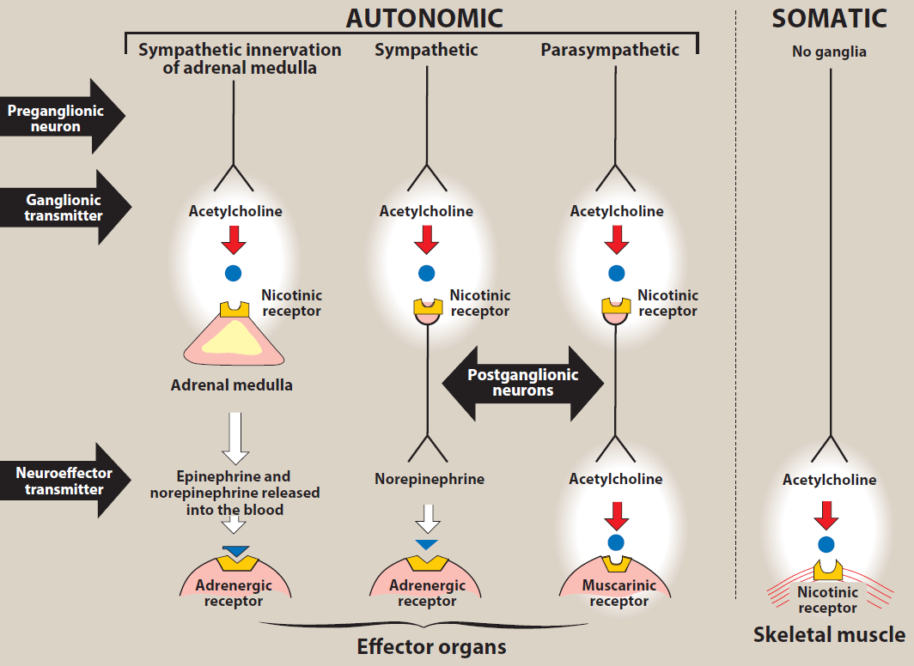

Slide 8
B. Indirect acting agents
Act by inhibiting acetylcholinesterase, which hydrolyzes acetylcholine. acetylcholine stimulates cholinoceptors to evoke increased responses. These include:-
Reversible: Physostigmine, Neostigmine, Pyridostigmine, Edrophonium.
Irreversible (toxic): Organophosphats as Dyflos, Echothiophate.

Slide 9
A. Direct-acting cholinergic agonists:
Pharmacokinetics
Choline esters are poorly absorbed and poorly distributed into the central nervous system because they are hydrophilic.
more resistant to hydrolysis by cholinesterase and have longer durations of action.

Slide 10
Actions of Direct-acting cholinergic agonists
They cause decrease in cardiac rate (negative chronotropy) and stroke volume.
increases salivary secretion and stimulates intestinal secretions and motility.
they enhances bronchiolar secretions.
Stimulate detrusor muscle, causing urination

Slide 11
stimulation of ciliary muscle contraction for near vision and in the constriction of the pupillae sphincter muscle, causing miosis (marked constriction of the pupil).

Slide 12
Bethanechol
increase intestinal motility and tone.
It also stimulates the detrusor muscle of the bladder, whereas the trigone and sphincter muscles are relaxed.
These effects produce urination.
it's used to stimulate the atonic bladder in postpartum or postoperative, nonobstructive urinary retention.

Slide 13
Adverse effects: sweating, salivation, flushing, decreased blood pressure, nausea, abdominal pain, diarrhea, and bronchospasm.

Slide 14
Pilocarpine
has muscarinic activity and used topically in treatment of glaucoma by contraction of the ciliary muscle.
is the drug of choice for emergency lowering of intraocular pressure in glaucoma.

Slide 15
Adverse effects:
Pilocarpine can cause blurred vision, night blindness.
Poisoning with this agent is characterized by various parasympathetic effects as sweating and salivation.

Slide 16
Indirect-acting cholinergic agonist
these drugs can provoke a response at all cholinoceptors in the body, including both muscarinic and nicotinic.
receptors of the ANS, as well as at the NMJ and in the brain

Slide 17
Pharmacokinetics
Absorption of the quaternary carbamates (Edrophonium, Neostigmine) from the conjunctiva, skin, gut and lungs is poor
negligible CNS distribution.
Physostigmine, is well absorbed from all sites It is distributed into CNS
the duration of their effect is determined chiefly by the stability of the inhibitor-enzyme complex.

Slide 18
Lipid-soluble agents (physostigmine and organophosphates) have more marked muscarinic and CNS effects; stimulate ganglia but action on skeletal muscles is less prominent.
Lipid-insoluble agents (neostigmine, pyridostigmine and other quaternary ammonium compounds) produce more marked effect on the skeletal muscles, stimulate ganglia, they do not penetrate CNS and have no central effects.

Slide 19
Physostigmine
stimulates the muscarinic and nicotinic sites of the ANS.
Its duration of action is about 30 minutes to 2 hours.
Physostigmine can enter and stimulate the cholinergic sites in the CNS.

Slide 20
Therapeutic uses:
The drug increases intestinal and bladder motility, so it's used in atony of either organ.
Physostigmine is also used in the treatment of overdoses of drugs with anticholinergic actions, such as atropine.

Slide 21
Adverse effects:
The effects of physostigmine on the CNS may lead to convulsions when high doses are used.
Bradycardia and a fall in cardiac output may also occur.

Slide 22
Neostigmine
is absorbed poorly from the GI tract, and does not enter the CNS.
Its effect on skeletal muscle is greater than that of physostigmine.
Neostigmine has duration of action of 30 minutes to 2 hours.

Slide 23
Therapeutic uses:-
It is used to stimulate the bladder and GI tract.
Neostigmine is also used to manage symptoms of myasthenia gravis.

Slide 24
Adverse effects:
salivation, flushing, decreased blood pressure, nausea, abdominal pain, diarrhea, and bronchospasm.

Slide 25
organophosphate compounds bind covalently to AChE.
The result is a long-lasting increase in ACh at all sites where it is released.
toxic agents and were developed by the military as nerve agents.
compounds, such as parathion and malathion, are used as insecticides.

Slide 26
Organophosphates are absorbed from all sites including intact skin and lungs.
Many of these drugs are extremely toxic and were developed by the military as nerve agents.
Related compounds, such as parathion and malathion, are used as insecticides.
The major source of intoxications is pesticide use in agriculture and in the home.
.

Slide 27
chemical warfare agents (soman, sarin, VX) The
initial signs of intoxication are salivation, sweating, bronchial constriction, vomiting, and diarrhea.
Central nervous system involvement (cognitive disturbances, convulsions, and coma) usually follows rapidly.
overstimulation of nicotinic receptors at the neuromuscular junction cause muscle weakness, fatigue, muscle cramps, fasciculation, and paralysis.

Slide 28
Therapy always includes:
1. Maintenance of vital signs—respiration in
particular .
2. Decontamination to prevent further absorption—
this may require removal of all clothing and washing
3. Atropine parenterally in large doses, given to
control signs of muscarinic excess.
Pralidoxime, an AChE regenerator.
Reversible enzyme inhibitors. This prophylaxis can be achieved with pyridostigmine

Slide 30
Cholinoceptor antagonists
Cholinergic antagonist bind to (muscarinic or nicotinic) and prevent the effects of acetylcholine (ACh) and other cholinergic agonists.
they are divided into muscarinic and nicotinic antagonists.
The most clinically useful of these agents are selective blockers of muscarinic receptors.

Slide 31
Antimuscarinic drugs
Ex. Atropine, scopolamine block muscarinic receptors.
block the few sympathetic neurons that are cholinergic, such as those innervating the salivary and sweat glands.

Slide 32
Tissues most sensitive to atropine are the salivary, bronchial, and sweat glands. Secretion of acid by the gastric parietal cells is the least sensitive.

Slide 33
Pharmacokinetics
Atropine is tertiary amine. found in the plant Atropa belladonna.
Scopolamine (hyoscine) occurs in Hyoscyamus nigera.
The tertiary members used for their effects on the eye or the CNS.
Quaternary amine antimuscarinic have produce more peripheral effects and reduced CNS effects.

Slide 34
Absorption
tertiary antimuscarinic drugs are well absorbed from the gut some (eg, scopolamine) are even absorbed across the skin (transdermal route).
In contrast, only 10–30% of a dose of quaternary antimuscarinic drug is absorbed after oral administration.

Slide 35
Distribution
Atropine and the other tertiary agents are widely distributed in the body and enter the CNS
quaternary derivatives are poorly taken up by the brain and therefore are relatively free—at low doses—of CNS effects.

Slide 36
Atropine
Atropine acts both centrally and peripherally. actions last about 4 hours.
The greatest effects are on bronchial tissue and the secretion of sweat and saliva.

Slide 37
Pharmacokinetics
Atropine is readily absorbed,
partially metabolized by the liver, About 50% of the dose is excreted unchanged in the urine.
Most of the rest appears in the urine as hydrolysis and conjugation products. It has a half-life of about 4 hours.

Slide 38
Therapeutic uses
a. Antispasmodic: Atropine is used as an antispasmodic agent to relax the GI tract.
b. Cardiovascular: The drug is used to treat bradycardia of varying etiologies.
c. Antisecretory: Atropine is sometimes used as an antisecretory agent to block secretions in the upper and lower respiratory tracts prior to surgery.

Slide 39
d. Antidote for cholinergic agonists: Atropine is used for the treatment of organophosphate (insecticides, nerve gases) poisoning, of overdose of clinically used anticholinesterases such as physostigmine,

Slide 40
Adverse effects
dry mouth, blurred vision. tachycardia, urinary retention, and constipation.
Effects on the CNS include restlessness, confusion, hallucinations, and delirium, which may progress to depression, collapse of the circulatory and respiratory systems, and death
Low doses of cholinesterase inhibitors, such as physostigmine, may be used to overcome atropine toxicity

Slide 41
The drug may be dangerous in children, because they are sensitive to its effects, particularly to rapid increases in body temperature.

Slide 42
Scopolamine
Scopolamine another tertiary amine has a longer duration of action as compared to atropine.
1. Actions: one of the most effective anti–motion sickness drugs available.
2. Therapeutic uses: The therapeutic use of scopolamine is limited to prevention of motion sickness and postoperative nausea and vomiting.

Slide 43
Benztropine and trihexyphenidyl
Benztropine and trihexyphenidyl are useful as adjuncts with other antiparkinsonian agents to treat Parkinson’s disease and other types of parkinsonian syndromes, including antipsychotic induced extrapyramidal symptoms.

Slide 44
Darifenacin, fesoterodine, oxybutynin, solifenacin, tolterodine, and trospium chloride
These drugs are used to treat overactive bladder.
By blocking muscarinic receptors in the bladder, intravesical pressure is lowered, bladder capacity is increased, and the frequency of bladder contractions is reduced.

Slide 45
Adrenergic agonists
sympathetic stimulation are mediated by release of norepinephrine from nerve terminals, which then activates adrenoceptors on postsynaptic sites.
In stress, the adrenal medulla releases epinephrine, which is transported in the blood to target tissues.

Slide 46
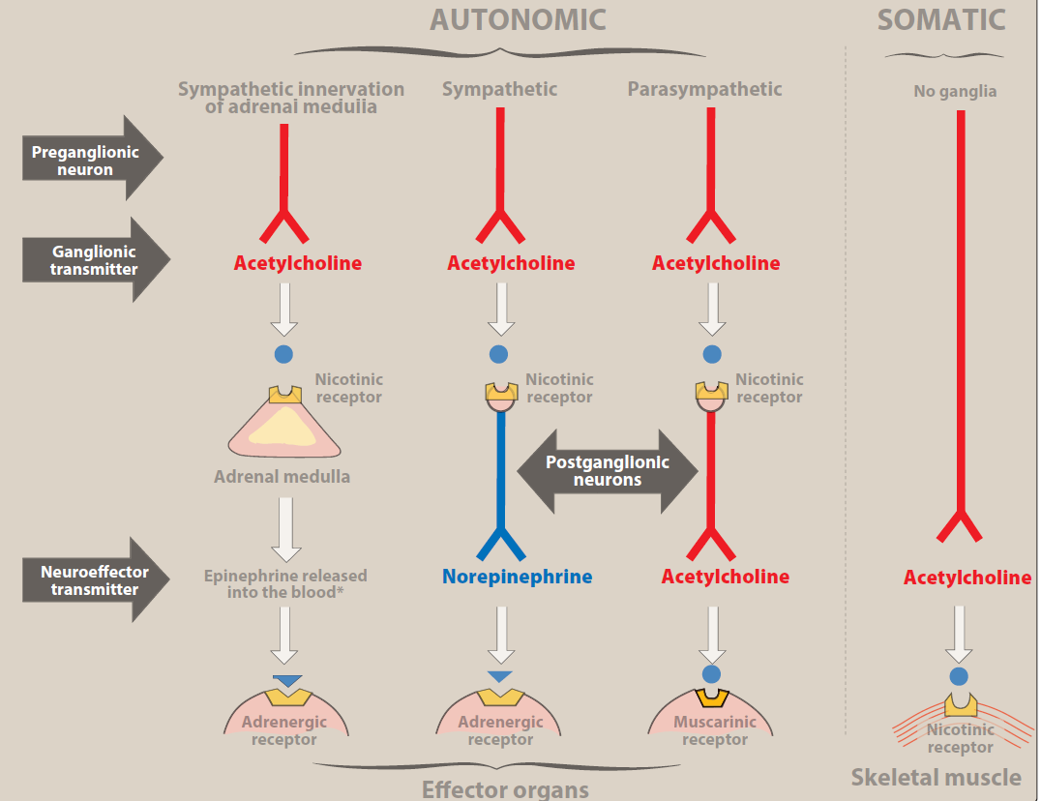

Slide 47
Drugs that mimic the actions of epinephrine or norepinephrine are termed sympathomimetic.
drugs and drugs that block the activation of adrenergic receptors are termed sympatholytics.

Slide 48
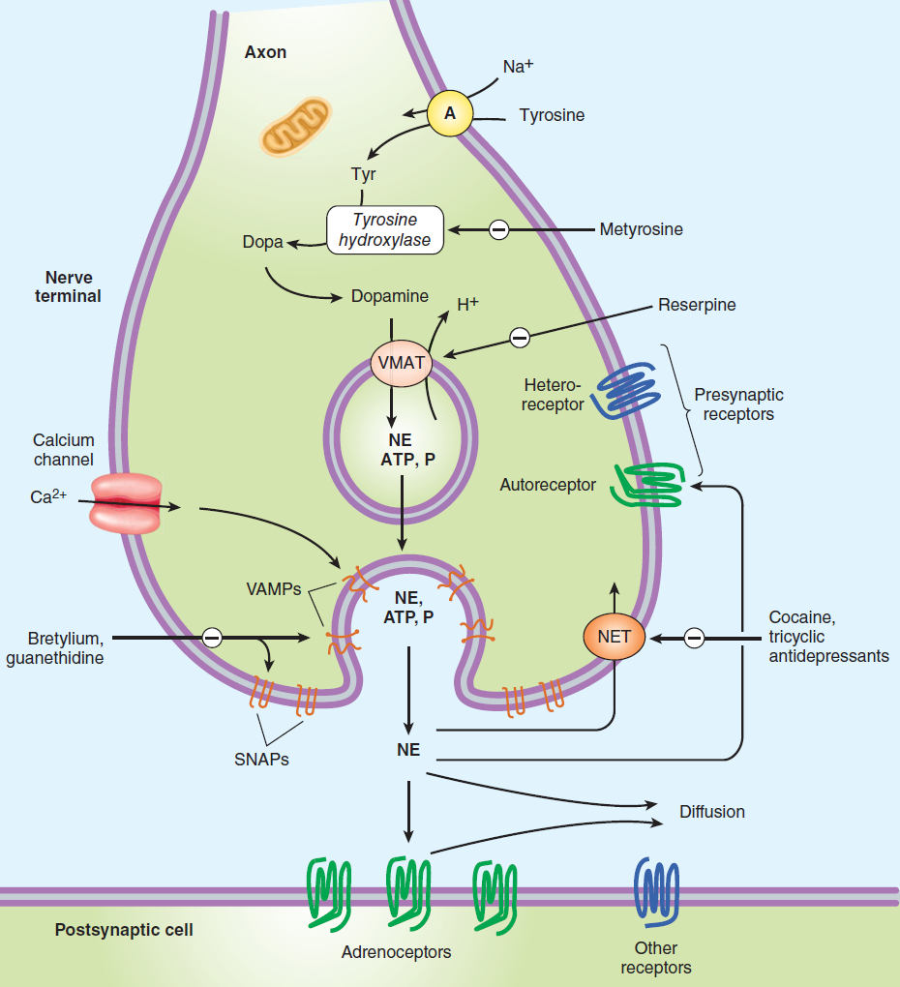
Adrenergic Transmission

Slide 49
adrenoceptors
two main families of receptors, α and β, are classified on the basis of their responses to the adrenergic agonists epinephrine, norepinephrine, and isoproterenol.
Each of these main receptor types has a number of specific receptor subtypes that have been identified.

Slide 50
α-Adrenoceptors
For α receptors, the rank order of potency and affinity is.
epinephrine ≥ norepinephrine >> isoproterenol.
The α-adrenoceptors are subdivided into two subgroups, α1 and α2.
the α1 receptors have a higher affinity for phenylephrine than α2 receptors.

Slide 51
α1 Receptors
mediate many of the effects as constriction of smooth muscle.
Activation of α1 receptors initiates a series of reactions through the G protein and the generation of second messengers (IP3).

Slide 52
Major effects mediated by α1 adrenoceptors:
Most vascular smooth muscle: cause Vasoconstriction, Increased blood pressure and peripheral resistance.
Pupillary dilator muscle (Iris radial muscle): Contraction which lead to Mydriasis.
bladder : Increased closure of internal sphincter of the bladder

Slide 53
α2 Receptors
These receptors are located on sympathetic presynaptic nerve endings and acting as inhibitory autoreceptors.
α2 receptors are also found on presynaptic parasympathetic neurons. behaving as inhibitory heteroreceptors.

Slide 54
Other α2 Receptors effects
Inhibition of insulin release
Fat cells: Inhibits lipolysis.

Slide 55
2. β-Adrenoceptors: For β receptors, the order of potency is
isoproterenol > epinephrine > norepinephrine.
The β-adrenoceptors can be subdivided into β1, β2, and β3, based on their affinities for adrenergic agonists and antagonists.
β1 receptors have equal affinities for epinephrine and norepinephrine,

Slide 56
β2 receptors have a higher affinity for epinephrine than for norepinephrine. Thus, tissues with a predominance of β2 receptors (such as the vasculature of skeletal muscle) are particularly responsive to the effects of circulating epinephrine released by the adrenal medulla.

Slide 57
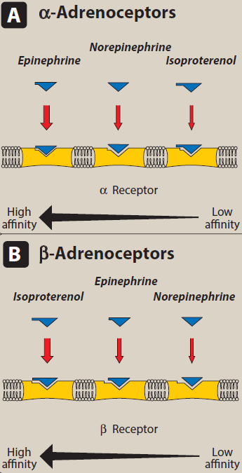

Slide 58
Binding of a neurotransmitter to β receptors results in activation of adenylyl cyclase and increased concentrations of cAMP within the cell.

Slide 59
Major effects mediated β1 adrenoceptors:
Heart: Increases force and rate of contraction ( Tachycardia and Increased myocardial Contractility).
Fat cell: Increased lipolysis.
Juxtaglomerular cells in kidney: Increased release of renin.

Slide 60
Major effects mediated β2 adrenoceptors
Bronchiolar smooth muscle: Promotes smooth muscle relaxation and cause Bronchodilation.
Skeletal muscle vascular smooth muscle: relaxation and cause Vasodilation and decreased peripheral resistance.
Increased muscle and liver glycogenolysis.
Increased release of glucagon.
Uterus: Relaxed uterine smooth muscle.

Slide 61
The sympathomimetics can be classified by mechanism of action into:-
1- Direct agonists: as norepinephrine and epinephrine, they directly interact with and activate adrenoceptors.
2- Indirect agonists: their actions are dependent on their ability to enhance the actions of endogenous catecholamines.

Slide 62
the adrenergic agonist are either catecholamines or noncatecholamines.
A. Catecholamines: Sympathomimetic amines that contain the 3,4-dihydroxybenzene group (such as epinephrine, norepinephrine, isoproterenol, and dopamine).

Slide 63
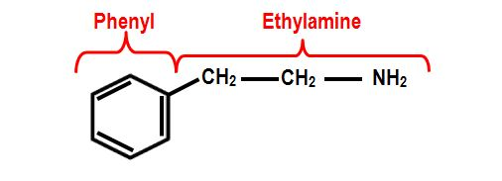

Slide 64
Catecholamines properties
1. High potency: Catecholamines show the highest potency in directly activating α or β receptors.
2. Rapid inactivation: Catecholamines are metabolized by COMT postsynaptically and by MAO intraneuronally, Thus catecholamines have only a brief period of action when given parenterally, and they are inactivated (ineffective) when administered orally.

Slide 65
3. Poor penetration into the CNS: Catecholamines are polar and, therefore, do not readily penetrate into the CNS.

Slide 66
Direct-acting adrenergic agonists
A. Epinephrine
Epinephrine interacts with both α and β receptors. At low doses, β effects (vasodilation) on the vascular system predominate, whereas at high doses, α effects (vasoconstriction) are the strongest.

Slide 67
Actions
Cardiovascular: (positive inotrope and chronotropic actions.
Epinephrine cause production of angiotensin II, a potent vasoconstrictor.
Epinephrine constricts arterioles in the skin, mucous membranes, and viscera (α effects),

Slide 68
dilates vessels going to the liver and skeletal muscle (β2 effects).increase in systolic blood pressure, coupled with a slight decrease in diastolic pressure due to β2 receptor–mediated vasodilation in the skeletal muscle vascular bed.

Slide 69
b. Respiratory: bronchodilation by acting directly on bronchial smooth muscle (β2 action).
c. Hyperglycemia: Epinephrine has a significant hyperglycemic effect because of increased glycogenolysis in the liver (β2 effect), increased release of glucagon (β2 effect), and a decreased release of insulin (α2 effect).
d. Lipolysis through agonist activity on the β receptors of adipose tissue.

Slide 70
Therapeutic uses
a. Bronchospasm: Epinephrine is used in the emergency treatment of acute asthma and anaphylactic shock.
b. Anaphylactic shock: treatment of type I hypersensitivity reactions (including anaphylaxis) in response to allergens.
c. Cardiac arrest: Epinephrine may be used to restore cardiac rhythm in patients with cardiac arrest.

Slide 71
d. Anesthetics:
Epinephrine greatly increases the duration of local anesthesia and systemic toxicity of local anaesthetic is reduced.
It is routinely included in dental anesthesia (unless contraindicated).
reduce bleeding as well.

Slide 72
B. Norepinephrine
the α-adrenergic receptor is most affected.
1. Cardiovascular actions:
a. Vasoconstriction: Norepinephrine causes a rise in peripheral resistance due to intense vasoconstriction of most vascular beds, including the kidney (α1 effect). Both systolic and diastolic blood pressures increase.

Slide 73
Therapeutic uses
Norepinephrine is used to treat shock, because it increases vascular resistance and, therefore, increases blood pressure.

Slide 74
Albuterol and terbutaline.
are short-acting β2 agonists used as bronchodilators and administered by a metered-dose inhaler.
for the management of acute asthma symptoms.

Slide 75
Salmeterol and formoterol
Salmeterol and formoterol are longacting β2 selective agonists provides sustained bronchodilation over 12 hours, compared with less than 3 hours for albuterol.

Slide 76
Indirect-acting adrenergic agonists
Indirect-acting adrenergic agonists cause the release, inhibit the reuptake, or inhibit the degradation of epinephrine or norepinephrine. They potentiate the effects of epinephrine or norepinephrine produced endogenously, but do not directly affect postsynaptic receptors.

Slide 77
A. Amphetamine
has central stimulatory action so used by drug abusers .
the drug can also increase blood pressure significantly by α1 agonist action on the vasculature, as well as β1-stimulatory effects on the heart.
Its action by increase the release of catecholamines such as dopamine and norepinephrine from nerve terminals. Thus, amphetamine is an indirect-acting adrenergic drug. Its used as CNS stimulants

